Slide 1
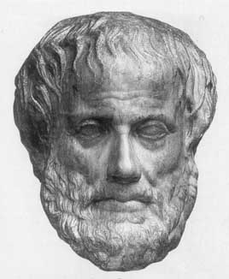
Artificial Intelligence (AI)
Junfeng Yao
Xiamen University
Slides used in the classroom only

Slide 2
Course overview
About this course
Problems and Programs

Slide 3
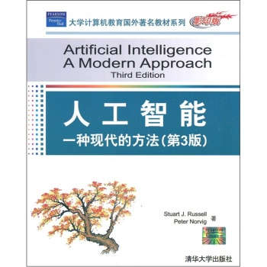

Slide 4
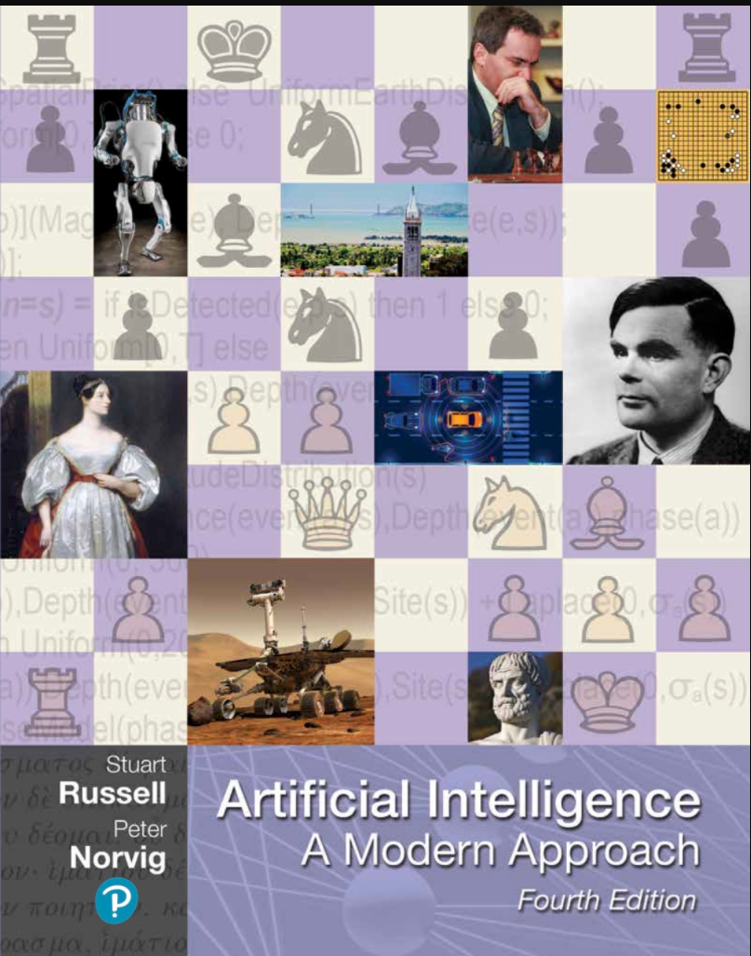
http://aima.cs.berkeley.edu/

Slide 5
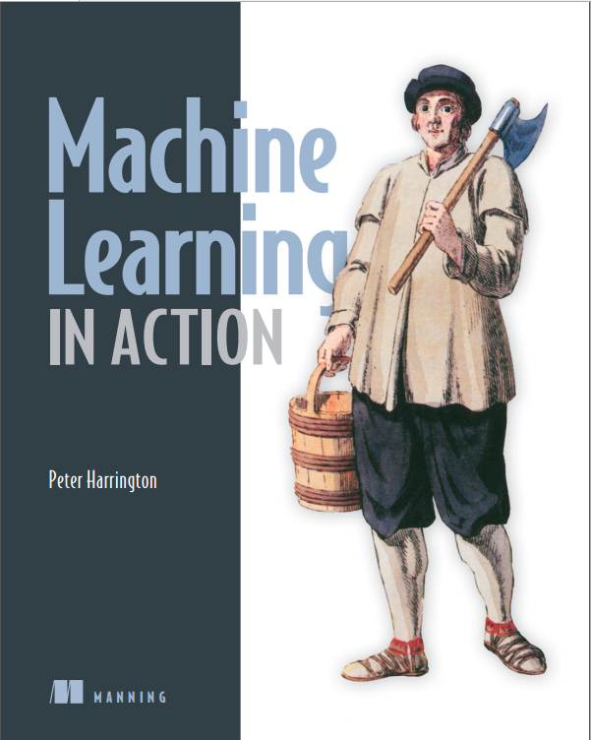

Slide 6
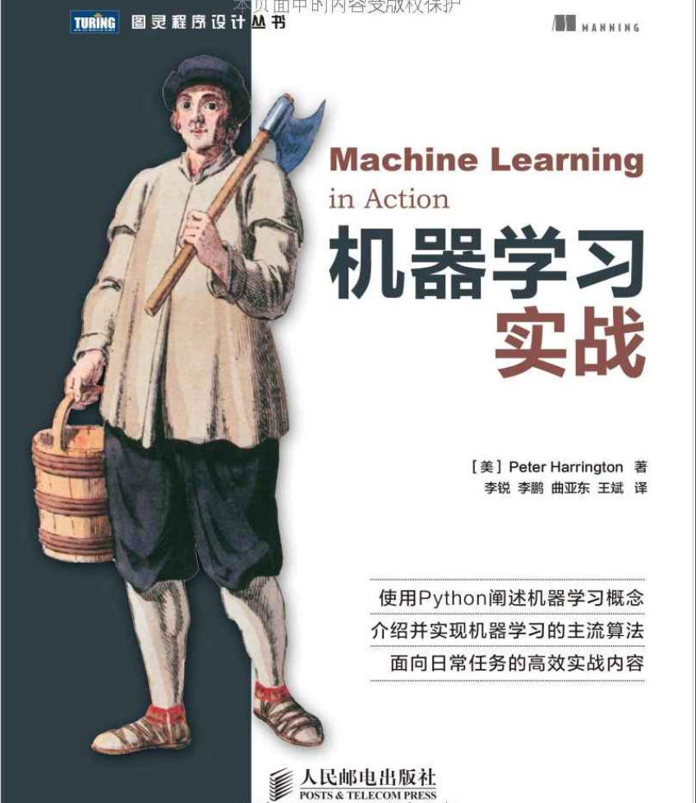

Slide 7
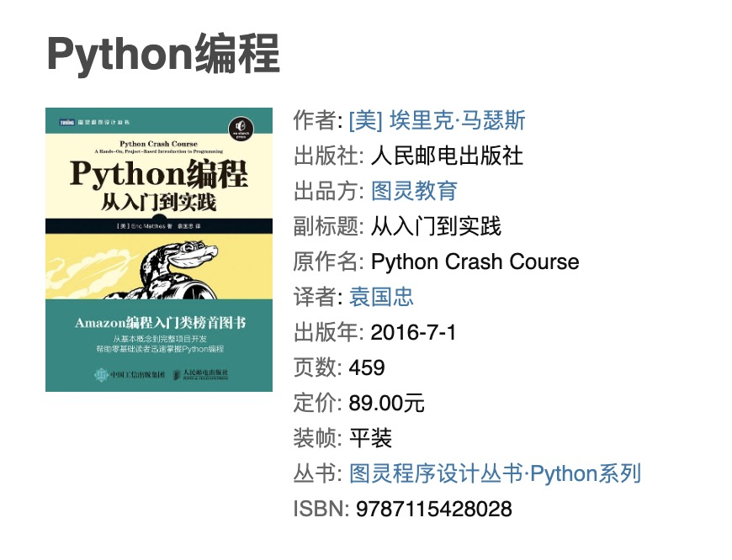

Slide 8
State of the Art
Deep Blue beats Kasparov.
Sojourner, Spirit, and Opportunity explore Mars.
NASA Remote Agent in Deep Space I probe explores solar system.
DARPA grand challenge: Autonomous vehicle navigates across desert. (Urban Challenge next)
iRobot Roomba automated vacuum cleaner.
Automated speech/language systems for airline travel.
Spam filters using machine learning.
Question answering systems automatically answer factoid questions.
Usable machine translation thru Google.

Slide 9
Designed Especially for You
Designed for students
  Broad coverage of topics
  Less background in computing, e.g., logic
  Need know how to program
  Some knowledge in mathematics
  Attempt to avoid complex maths
    Focus on algorithmic details

Slide 10
Quick Questions about AI
What is Artificial Intelligence?
  question (because AI is young)
  Quick answer: getting machines to do smart things
Where did Artificial Intelligence originate?
  AI is not “owned” by computer science
  Origins in (at least): maths, logic, computer science,
  philosophy, psychology, cognitive science, biology
  Understanding intelligence one of the oldest questions
  Turing introduced AI notions in his seminal work
  “AI” coined by John McCarthy in Dartmouth, 1956

Slide 11
Definitions of AI
Short
  Russell Beale, University of Birmingham, UK: AI can be defined as the attempt to get real machines to behave like the ones in the movies.

Slide 12
Definitions of AI
Short
  John McCarthy, Stanford University: It is the science and engineering of making intelligent machines, especially intelligent computer programs. It is related to the similar task of using computers to understand human intelligence, but AI does not have to confine itself to methods that are biologically observable.

Slide 13
Definitions of AI
Short
  Ron Brachman, AAAI: There's a lot to try to understand about the kind of reasoning and learning that people do that's very different than sort of classical, von Neumann, step-by-step computer algorithms.

Slide 14
Definitions of AI
Long (Aaron Sloman, University of Birmingham, UK): Physics and chemistry study matter, energy, forces, and the various ways they can be combined and transformed.
Biology, geology, medicine, and many other sciences and engineering disciplines build on this by studying more and more complex systems built from physical components.
All this research requires an understanding of naturally occurring and artificial machines which operate on forces, energy of various kinds, and transform or rearrange matter. But some of the machines, both natural and artificial, also manipulate knowledge. It is now clear that a new kind of science is required for the study of the principles by which

Slide 15
Definitions of AI
knowledge is acquired and used,
goals are generated and achieved,
information is communicated,
collaboration is achieved,
concepts are formed,
languages are developed.
We could call it the science of knowledge or the science of intelligence.

Slide 16
Common Misconceptions
From popular science/science fiction/media
Robots will take over the earth
  Kevin Warwick
Computers will never be intelligent
  Roger Penrose
Humans will choose to become computers
  Ray Kurzweil
Computers will evolve to be human
  Mark Jeffery

Slide 17
Course Aims
Assumption:
  You will be going off to industry/academia
  Will come across computational problems
    requiring intelligence (in humans and computers) to solve
Two aims:
  Give you an understanding of what AI is
    Aims, abilities, methodologies, applications, …
  Equip you with techniques for solving problems
    By writing/building intelligent software/machines

Slide 18
Course Overview: four areas
AI fundamentals
  Characterisations, terminology, methodologies
  Representation and search
  Application to game playing
Automated reasoning (deduction)
  Socrates was mortal
Machine learning (induction)
  Every man has died, so we all die
Evolutionary algorithms
  Breed your own programs

Slide 19
Administration
My details
  (yao0010@xmu.edu.cn), Administrative Building C413
Course details
  Lectures: Monday 8:00–9:40 AM (2-108)
  Experiment: Single Mon 10:10–11:50 AM (4-102)
  ftp://121.192.180.236 User: student Pw: software
TA: Jungyuan Wang
Lab：VS 2017(C++),Anaconda(Python)

Slide 20
Course Objectives
To provide an introduction to the basic principles and applications of Artificial Intelligence.
Programming assignments are used to help clarify basic concepts.
The emphasis of the course is on teaching the fundamentals, and not on providing a mastery of specific commercially available software tools or programming environments. In short, this course is about the design and implementation of intelligent agents---software or hardware entities that perform useful tasks with some degree of autonomy.

Slide 21
Course Objectives …
Upon successful completion of the course, students will have an understanding of the basic areas of artificial intelligence including problem solving, knowledge representation, reasoning, decision making, planning, perception and action, and learning -- and their applications (e.g., data mining, information retrieval).
Students will also be able to design and implement key components of intelligent agents of moderate complexity in Java and/or Python or Prolog and evaluate their performance.
Graduate students are expected to develop familiarity with current research problems, research methods, and the research literature in AI.

Slide 22
Assignments
Lecture schedule
7 programming assignments
Examinations
Research Projects

Slide 23
Programming/project grading
(Software Engineering)
Elegant solution.
Logical thinking.
Quality of writing and coding
Concise writing is a virtue.
Tell the reader only what is important.
Complete Documentation.

Slide 24
Research Project Guidelines
Research projects should consist of the following components:
  Define the problem to be solved
  Background information
  Algorithms and Applications
  Implementation
  Drawbacks
  New applications and discoveries

Slide 25
Research Project Guidelines …
Some examples of research projects:
  AI+MUSIC
  AI+VIDEO
  AI+DESIGN
  AI+ART
  AI+STORYTELLING
  AI+SECURITY
  AI+PERFORMANCE

Slide 26
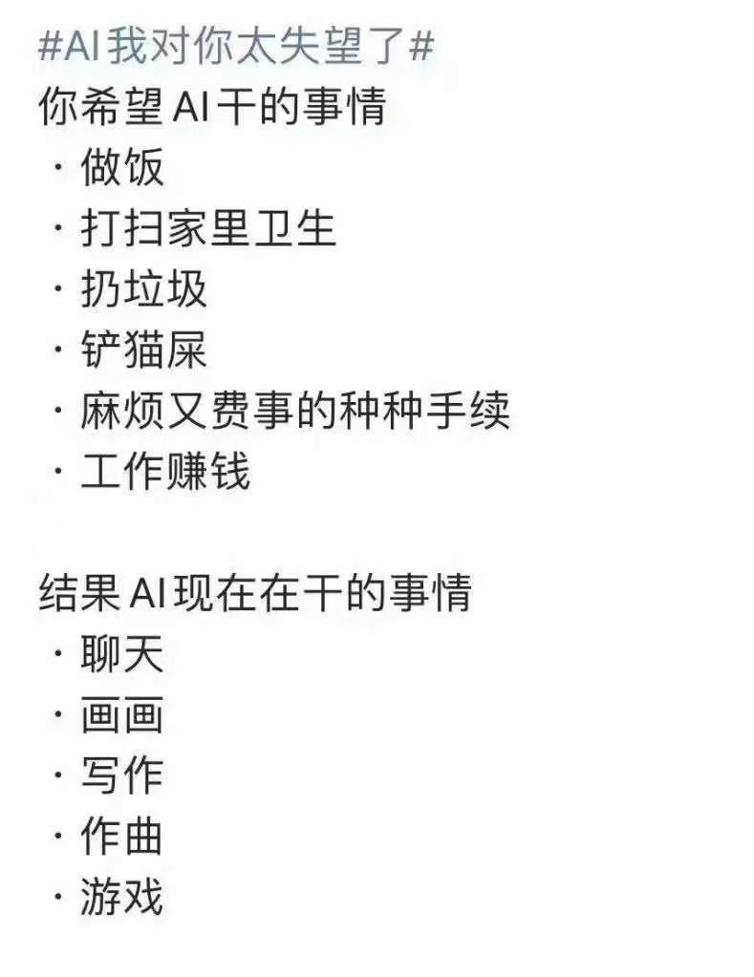

Slide 27
大模型作业：
请自行选择某工作流(至少包括六个工作环节)， 分别用什么大模型可以帮助人类工作并给出示例。
2025年3月12日22:00前上传至FTP。

Slide 28


Questions & Suggestions?
The End

